Slide 1
Data quality

Slide 2
Data Quality
Data quality is a measure of the condition of data based on factors such as accuracy, completeness, consistency, reliability and whether it's up to date
Some of the most common issues affecting data quality are inconsistent formatting of dates and numbers, unusual character sets and symbols, duplicate entries, and different languages and measurement units
Measuring data quality levels can help organizations identify data errors that need to be resolved and assess whether the data in their IT systems is fit to serve its intended purpose
High-quality data is the foundation of all digital business
A multi-dimensional measure of data quality:
A well-accepted multi-dimensional view:
accuracy, completeness, consistency, timeliness, believability, value added, interpretability, and accessibility

Slide 3
Data Quality
Accuracy (Is the information correct in every detail)
As the name implies, this data quality characteristic means that information is correct. There is no error in it. The data should reflect actual, real-world scenarios. Accuracy is a crucial data quality characteristic because inaccurate information can cause significant problems with severe consequences e.g – if there’s an error in a customer’s bank account, it could be because someone accessed it without his knowledge
Completeness (How comprehensive is the information)
Data completeness is how exhaustive a dataset is. Completeness is a measure of the data’s ability to effectively deliver all the required values that are available. It refers to how comprehensive the information is. If information is incomplete, it might be unusable.
Consistency/Reliability (Does the information contrdict other trusted resourses?)
Data consistency refers to the uniformity of data as it moves across networks and applications. The same data values stored in difference locations should not conflict with one another.

Slide 4
Quality of data
Relevance (Do you really need this information)/Timeliness (How up-to-date is information)
Data relevance is a more subjective measure of data quality. It looks at whether data is sufficiently complete, uniform, consistent (and so on) to fulfill its given task. Another aspect of data relevance, though, is timeliness.Timely data is data that is available when it is required. Data may be updated in real time to ensure that it is readily available and accessible. The timeliness of information is an important data quality characteristic, because information that isn’t timely can lead to people making the wrong decisions. In turn, that costs organizations time, money, and reputational damag
Interpretability
It reflects how easy the data are understood.

Slide 5
Step 2: To explore the dataset
Preliminary investigation of the data to better understand its specific characteristics
It can help to answer some of the data mining questions
To help in selecting pre-processing tools
To help in selecting appropriate data mining algorithms
Things to look at
Class balance
Dispersion of data attribute values
Skewness, outliers, missing values
Attributes that vary together
Visualization tools are important
Histograms, scatter plots
Notes:
Step 1: describe the dataset

Slide 6
Useful statistics
Discrete attributes
Frequency of each value
Mode = value with highest frequency
Continuous attributes
Range of values, i.e. min and max
Mean (average)
Sensitive to outliers
Median:
Better indication of the ”middle” of a set of values in a skewed distribution
Skewed distribution
mean and median are quite different

Slide 7
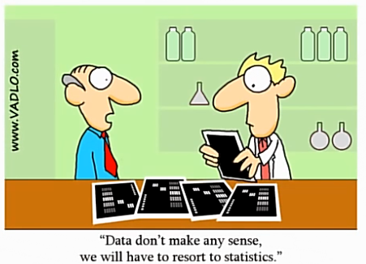
Descriptive Statistics
Describes the data in a qualitative or quantitative manner
Provides a summary of the shape of the data
These statistics help us to understand when transformations, imputations, and removal of outliers are necessary prior to model building

Slide 8
Descriptive Statistics
Descriptive Statistics are a collection of measurements of two things:
Location
Variability
Location tells you of the central value of your variable (e.g., mean, median, mode).
Variability refers to the spread of the data from the center value (e.g., variance, standard deviation, range)
Statistics is essentially the study of what causes variability in the data.
Notes:
Central tendency is a descriptive summary of a dataset through a single value that reflects the center of the data distribution

Slide 9
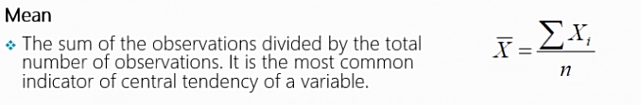
Descriptive Statistics –Location (Measures of central tendency)
Looking at the retirement age distribution: 54, 54, 54, 55, 56, 57, 57, 58, 58, 60, 60
Advantage of the mean: The mean can be used for both continuous and discrete numeric data. Limitations of the mean: The mean cannot be calculated for categorical data, as the values cannot be summed.
Mean is not robust because a single large value(an outlier) can skew the average
Notes:
Mean=623/11=56.6

Slide 10
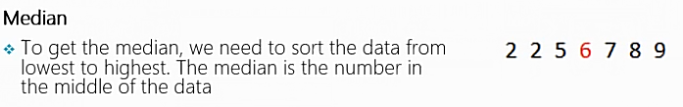
Measures of central tendency: Median
The median is less affected by outliers and skewed data than the mean, and is usually the preferred measure of central tendency when the distribution is not symmetrical.
Notes:
Limitation of the median: The median cannot be identified for categorical nominal data, as it cannot be logically ordered.

Slide 11

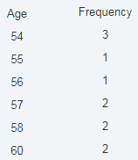
Measures of central tendency: Mode
Consider this dataset showing the retirement age of 11 people, in whole years: 54, 54, 54, 55, 56, 57, 57, 58, 58, 60, 60
The mode has an advantage over the median and the mean as it can be found for both numerical and categorical (non-numerical) data. Limitations of the mode: The are some limitations to using the mode. In some distributions, the mode may not reflect the center of the distribution very well.

Slide 12
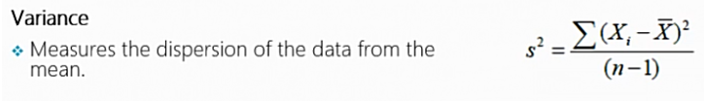
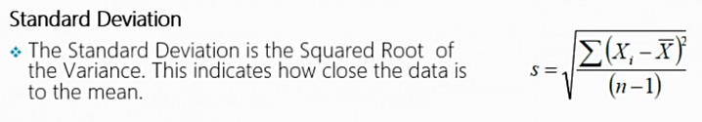
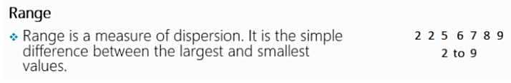
Descriptive Statistics – Variability (measures of dispersion)
The measures of dispersion give an indication about the spread or variation in the values.

Slide 13
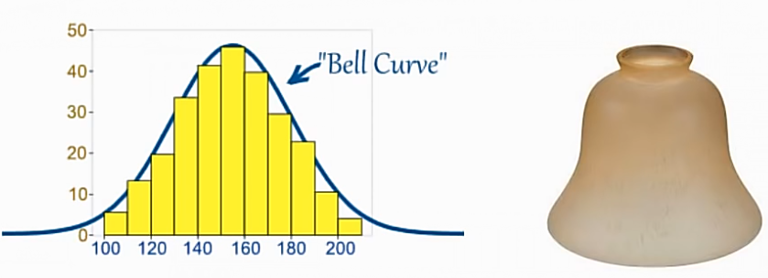
Normal Distribution
There are many cases where the data tends to be around a central value with no bias left or right, and it gets close to a "Normal Distribution" like this:
The "Bell Curve" is a Normal Distribution. The yellow histogram shows some data that follows it closely, but not perfectly (which is usual).

Slide 14
Normal Distribution
Many things follow a normal distribution:
Height of People
Size of things produced by machines
Errors in measurements
Blood Pressure
Academic Test Scores

Slide 15
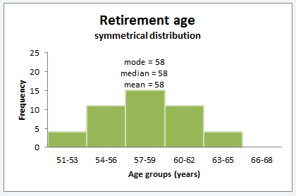
How does the shape of a distribution influence the Measures of Central Tendency?
Symmetrical distributions: When a distribution is symmetrical, the mode, median and mean are all in the middle of the distribution.
The following graph shows a larger retirement age dataset with a distribution which is symmetrical. The mode, median and mean all equal 58 years.

Slide 16
Skewness
A measure of asymmetry
Skewness refers to a distortion or asymmetry that deviates from the symmetrical bell curve, or normal distribution, in a set of data
When a distribution is skewed the mode remains the most commonly occurring value, the median remains the middle value in the distribution, but the mean is generally ‘pulled’ in the direction of the tails
In a skewed distribution, the median is often a preferred measure of central tendency, as the mean is not usually in the middle of the distribution.

Slide 17
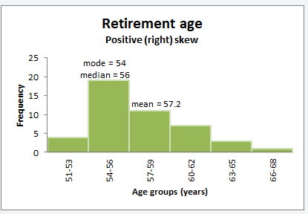
Positive skewness / right Skewed:
A distribution is said to be positively or right skewed when the tail on the right side of the distribution is longer than the left side.
In a positively skewed distribution it is common for the mean to be ‘pulled’ toward the right tail of the distribution.
Notes:
Although there are exceptions to this rule, generally, most of the values, including the median value, tend to be less than the mean value.

Slide 18
Negative skewness /left Skewed:
A distribution is said to be negatively or left skewed when the tail on the left side of the distribution is longer than the right side
In a negatively skewed distribution, it is common for the mean to be ‘pulled’ toward the left tail of the distribution
Notes:
Although there are exceptions to this rule, generally, most of the values, including the median value, tend to be greater than the mean value.

Slide 19
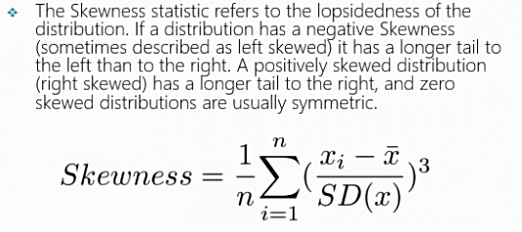
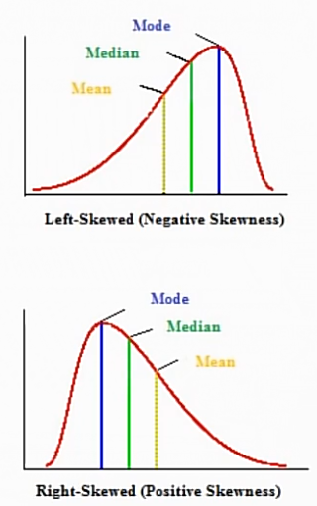
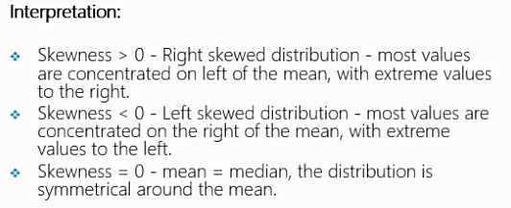
Normal Distribution

Slide 20
Exercise: Skewness Calculation
Calculate the skewness of the following dataset:
15,20,22,25,27,30,30,32,35,40,45,50,55,60,65,70

Slide 21
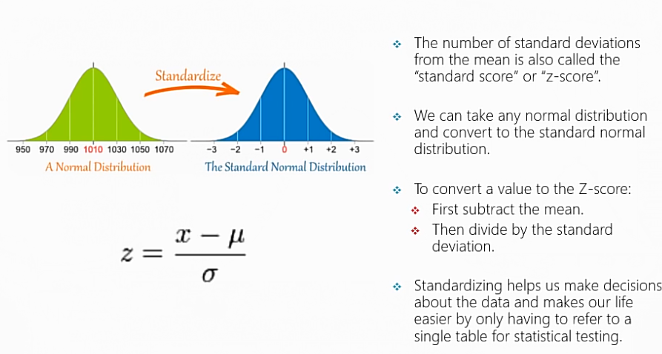
Standard Normal Distribution

Slide 22
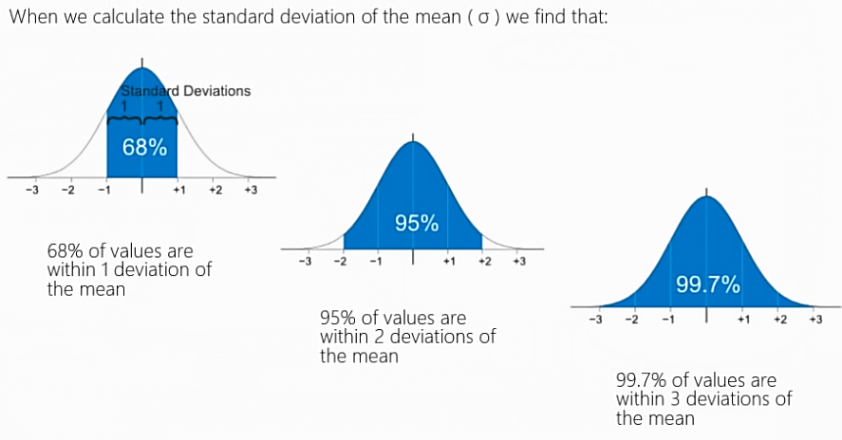
Standard Normal Distribution

Slide 23
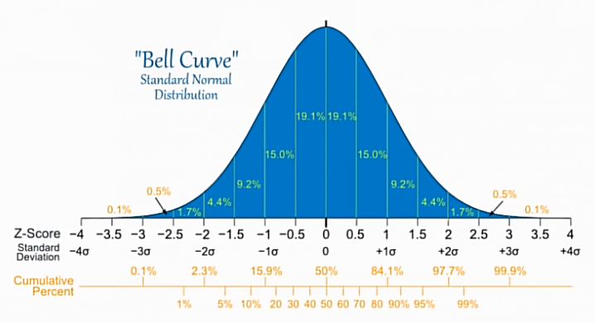
Standard Normal Distribution
Here is the Standard Normal Distribution with percentages for every half of a standard deviation, and cumulative percentages:

Slide 24
Agenda
Why data preprocessing?
Data cleaning
Data integration and transformation
Data reduction
Discretization

Slide 25
Why Data Preprocessing?
Data in the real world is dirty
incomplete: lacking attribute values, lacking certain attributes of interest, or containing only aggregate data
noisy: containing errors or outliers
inconsistent: containing discrepancies in codes or names
No quality data, no quality mining results!
Quality decisions must be based on quality data
Data warehouse needs consistent integration of quality data

Slide 26
Major Tasks in Data Preprocessing/Wrangling
Data cleaning
Fill in missing values, smooth noisy data, identify or remove outliers, and resolve inconsistencies
Data integration
Integration of multiple databases, data cubes, files, or notes
Data transformation
Normalization (scaling to a specific range)
Aggregation
Data reduction
Obtains reduced representation in volume but produces the same or similar analytical results
Data discretization: with particular importance, especially for numerical data
Data aggregation, dimensionality reduction, data compression, generalization

Slide 27
Major Tasks in Data Preprocessing

Slide 28
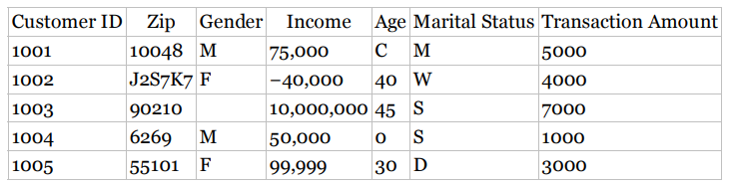
Why Data Preprocessing?
Notes:
Zip Code : five-numeral American zip code
customer 1002 has zip code of J2S7K7, unusual value as an error?
zip code (known as postal code in Canada) St. Hyancinthe, Quebec, Canada
What about the zip code for customer 1004
Zip codes for the New England states begin with the numeral 0
The zip code may well be 06269
gender, contains a missing value for customer 1003
income field has three potentially anomalous values.
customer 1003…. income of $10,000,000 per year, 90210, Beverly Hills
this value of income is nevertheless an outlier, an extreme data value
customer 1002's reported income of −$40,000 lies beyond the field bounds for income, and therefore must be an error
99,999 was coded in an old database to mean missing.
Again, we cannot be sure, and should again refer to the database administrator.
customer 1001's “age” of C probably reflects an earlier categorization of this man's age into a bin labeled C
1004 . More likely, the age of this person is probably missing, and was coded as 0 to indicate this or some other anomalous condition (e.g., refused to provide the age information).
does the S for customers 1003 and 1004 stand for single or separated?

Slide 29
Data Cleaning
Data cleaning tasks
Fill in missing values
Identify outliers and smooth out noisy data
Correct inconsistent data

Slide 30
Missing Data
Data is not always available
many tuples have no recorded value for several attributes, such as customer income in sales data
Missing data may be due to
Information is not collected (e.g., people decline to give their age and weight)
Attributes may not be applicable to all cases (e.g., annual income is not applicable to children)
equipment malfunction
inconsistent with other recorded data and thus deleted
data not entered due to misunderstanding
certain data may not be considered important at the time of entry
not register history or changes of the data
Missing data may need to be inferred

Slide 31
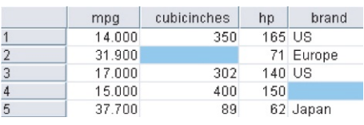
How to Handle Missing Data?
The data set consists of information about 261 automobiles manufactured in the 1970s and 1980s,
including gas mileage, number of cylinders, cubic inches, horsepower, and so on.
Notes:
mpg:Miles per gallon

Slide 32
How to Handle Missing Data?
Ignore the tuple: usually done when class label is missing (assuming the task is classification—not effective in certain cases)
Replace the missing value with some constant, specified by the analyst
Replace the missing value with the field mean/median (for numeric variables) or the mode (for categorical variables). Imputation using central tendency measures
Replace the missing value with the attribute mean/median for all samples of the same class
Replace the missing values with imputed values based on the other characteristics of the record: inference-based such as regression, Bayesian formula, decision tree

Slide 33
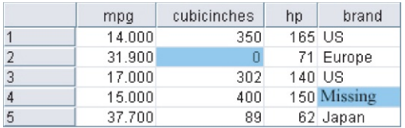
Replace the missing value with some constant, specified by the analyst
Notes:
replacing the missing values with the constant 0 for the numerical variable cubicinches
and the label missing for the categorical variable brand.

Slide 34
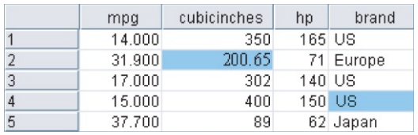
Replace the missing value with measure of central tendency:
Notes:
missing values may be replaced with the respective field means and modes

Slide 35
Noisy Data
Q: What is noise?
A: Random error in a measured variable.
Incorrect attribute values may be due to
faulty data collection instruments
data entry problems
data transmission problems
technology limitation
inconsistency in naming convention
Other data problems which requires data cleaning
duplicate records
incomplete data
inconsistent data
Notes:
Other data problems which requires data cleaning
duplicate records: Repeated data rows in the dataset are called duplicates. These can arise from a number of ways. The most common are:
The same data is entered twice by accident, such as the same article is scraped twice or booking for an online product is made twice.
If data is being collected in online forms or surveys and the user presses the submit button twice.
If data is collected from multiple sources.
incomplete data
inconsistent data

Slide 36
How to Handle Noisy Data?
How can we “smooth” out the data to remove the noise?
Binning methods
Clustering
detect and remove outliers
Regression
smooth by fitting the data into regression functions
Notes:
Binning methods smooth a sorted data value by consulting its “neighbor_x0002_hood,” that is, the values around it.

Slide 37
Bining method
Binning methods smooth a sorted data value by consulting its “neighborhood,” that is, the values around it
Sorted values are distributed into a number of “buckets,” or bins
first sort data and partition into (equi-depth/equi-width) bins
then one can smooth by bin means, smooth by bin median, smooth by bin boundaries, etc.
used also for discretization (discussed later)

Slide 38
Simple Discretization Methods: Binning
Equal-width (distance) partitioning:
It divides the range into N intervals of equal size: uniform grid
if A and B are the lowest and highest values of the attribute, the width of intervals will be: W = (B-A)/N.
The most straightforward
But outliers may dominate presentation
Skewed data is not handled well.
Equal-depth (frequency) partitioning:
It divides the range into N intervals, each containing approximately same number of samples
Good data scaling
Managing categorical attributes can be tricky.

Slide 39
Binning Methods for Data Smoothing
* Sorted data for price (in dollars): 4, 8, 9, 15, 21, 21, 24, 25, 26, 28, 29, 34
* number of Bins, N=3
* Partition into (equi-depth) bins:
- Bin 1: 4, 8, 9, 15
- Bin 2: 21, 21, 24, 25
- Bin 3: 26, 28, 29, 34
* Smoothing by bin means:
- Bin 1: 9, 9, 9, 9
- Bin 2: 23, 23, 23, 23
- Bin 3: 29, 29, 29, 29
* Smoothing by bin boundaries:
- Bin 1: 4, 4, 4, 15
- Bin 2: 21, 21, 25, 25
- Bin 3: 26, 26, 26, 34

Slide 40
Binning Methods for Data Smoothing
* Sorted data : 4, 8, 9, 15, 21, 21, 24, 25, 26, 28, 29, 34
* N=3
* Partition into (equi-width) bins

Slide 41
Outlier detection: Regression
y
Y1
Y1’
y = x + 1
X1
x
Linear regression (best line to fit
two variables)
Multiple linear regression (more
than two variables, fit to a
multidimensional surface

Slide 42
Outliers
Outliers are observations that are significantly distant from other observations
These do not follow the general trend of the data
Outliers can indicate variation or error in the data.
Outliers in a single variable/column are called univariate while outliers in multiple variables/columns are called multivariate.
Outliers can be caused by a variety of reasons. Some common ones are:
Errors in entering data
Errors in measuring data, e.g., errors in the measuring instrument
Errors in collecting and merging data from multiple sources
Errors in processing data
Natural variance because of some unknown reason

Slide 43
Outlier / anomalies detection
Outlier detection (also known as anomaly detection) is the process of finding data objects with behaviors that are very different from expectation.
Detecting outliers is a very important step in data cleaning and exploring
It gives us an idea of the anomalies in the data which can give us valuable insights into the data
So, how can we detect outliers?
Outliers can be detected both visually and mathematically
Some plots are very helpful in visualizing outliers, such as box plots and scatter plots
However, it is sometimes tricky to decide whether or not to remove the outliers
We should remove outliers when we are certain that these outliers were results of some errors

Slide 44
Outlier detection: Cluster Analysis

Slide 45
Numerical methods for identifying outliers: Z-score
z-score method for identifying outliers states that a data value is an outlier if it has a Z- score that is either less than or greater than 3.
Example: Suppose we have the following values for salary (in thousands of dollars), shown
in increasing order: 30, 36, 47, 50, 52, 52, 56, 60, 63, 70, 70, 110
Notes:
Unfortunately, the mean and SD, which are both part of the formula for the Z-score standardization, are both rather sensitive to the presence of outliers.

Slide 46
Numerical methods for identifying outliers: IQR(Inter Quartile range)
Robust statistical methods for outlier detection
Less sensitive to the presence of the outliers themselves
The quartiles of a data set divide the data set into the following four parts, each containing 25% of the data:
The first quartile (Q1) is the 25th percentile
The second quartile (Q2) is the 50th percentile, that is, the median.
The third quartile (Q3) is the 75th percentile
The IQR is a measure of variability, much more robust than the SD
IQR = Q3 − Q1
may be interpreted to represent the spread of the middle 50% of the data
A data value is an outlier if
a. it is located 1.5(IQR) below the first quartile Q1, or
b. it is located 1.5(IQR) above the third quartile Q3.
Notes:
The quartiles give an indication of a distribution’s center, spread, and shape.

Slide 47
How to Handle Inconsistent Data?
Inconsistency in data arises due to errors in collecting data. For instance, if the data was collected from multiple sources, or if the data was collected by multiple people who did not follow the same format of collecting data, then there is a high chance of inconsistencies in the data
Manual correction using external references
Semi-automatic using various tools
To detect violation of known functional dependencies and data constraints
To correct redundant data

Slide 48
THAT’S IT FOR TODAY!

